Slide 1
TOPDOWN APPOACH AND HOW TO APPLY IT TO THE ASSIGNMENT IN MY PROGRAM
Nguyen Duy Noa

Slide 2
Table of contents
01
02
04
05
What’s top-down approach?
How to apply?
03
Advantages and disadvantages
Example
How to apply it to assignment

Slide 3
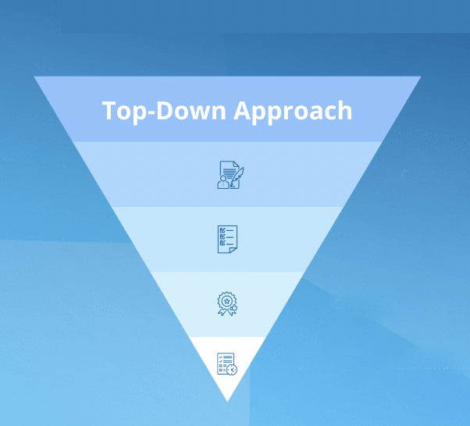
01. What is a top-down approach?
“Top-down approach” is a method of solving problems from the general to the small components

Slide 4
02. How to apply a top-down approach?
01
02
04
03
High-level view
Decomposition
Elaboration
Prioritization

Slide 5
03. Advantages and disadvantages
Effective Project Management | Lack of Flexibility
Clear Understanding of Objectives | lack of details
Time Savings | Development Delays
Ease of Management
Structured Organization

Slide 6
04. Example
e-commerce website basic
Front-end
Back-end
UI/UX Design
Build functional
Build logic
Architectural system
Testing
Coding
Build API
Store and retrieve data
Integrate with other systems

Slide 7
05. How to apply it to the assignment in my program
01
02
03
04
05
06
07
08
Determine the target
Divide into small parts
Prioritization
Elaboration
Research
Try
Repeat
Complete

Slide 8
Thanks!
for watching

